Slide 1






Mathematical Foundations for Computer Science
MOMENTUM IN OPTIMIZATION
Group info:
Bùi Nguyễn Gia Huy (2570201)
Lê Ngọc Minh Thư (2570331)
Nguyễn Xuân Trường (2570526)
Phạm Kiều Nhật Anh (2580805)
Lê Công Minh (2212044)
Presented by: Group 11
Date: December 13, 2025

Slide 2



04
PRACTICAL IMPLEMENTATION
01
INTRODUCTION
TABLE OF
CONTENTS
02
OPTIMIZATION PROBLEM
05
EXERCISES
03
MATHEMATICAL FOUNDATIONS
06
SUMMARY

Slide 3
INTRODUCTION
01

Slide 4







What is momentum?
What is it? And what is the usage?
Momentum introduces a velocity term that accumulates past gradients to smooth the update direction and improve the convergence speed.
Key benefits of Momentum:
Smooth noisy updates
Reduces zig-zagging in narrow valleys
Speeds up convergence in flat regions
More stable than plain SGD

Slide 5
OPTIMIZATION
PROBLEM
02

Slide 6

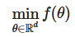

Optimization Problem
The core task in deep learning optimization is to find the set of parameters θ that minimizes the objective (loss) function f(θ)
The loss landscape in deep learning
Highly non-convex
Contains narrow valleys, plateaus, saddle points
Gradient direction changes rapidly depending on curvature

Slide 7
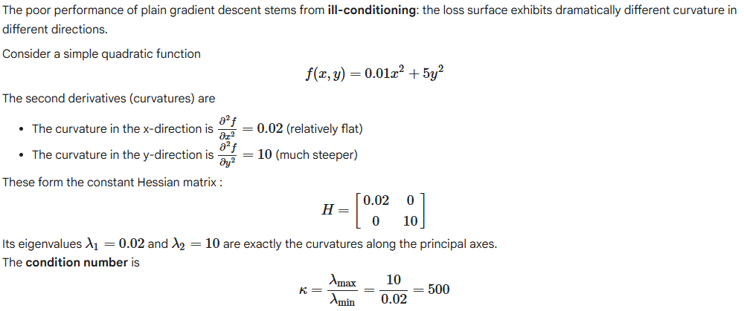
Ill-Conditioning Problem
Gradient descent dilemma:
Small learning rate: stable in y direction but slow in x-direction
Large learning rate: good progress in x-direction but risks divergence in y-direction

Slide 8
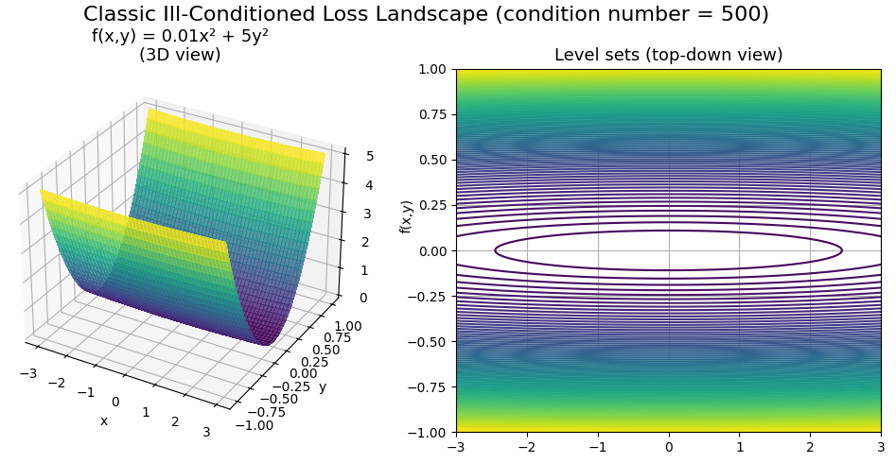
Ill-Conditioning Problem

Slide 9
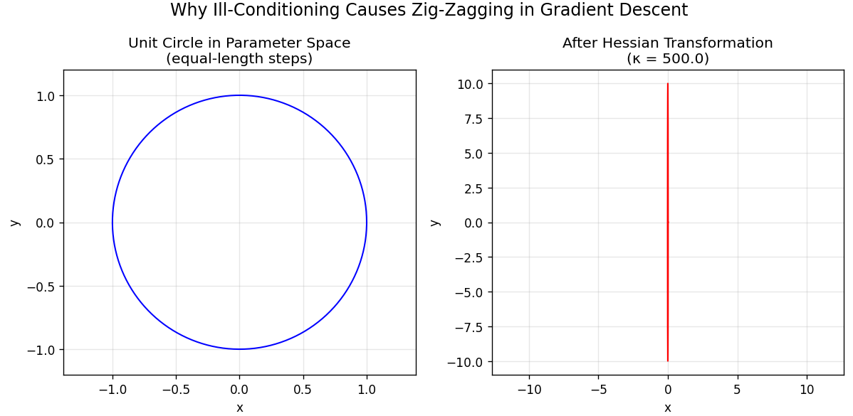
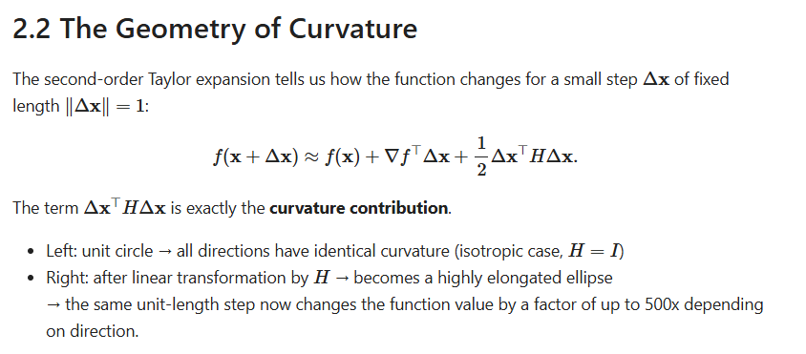
Geometry of Curvature

Slide 10





Momentum Solution
Damps Oscillation
Maintains Inertia
Reduces Noise Sensitivity
By accumulating previous updates, it reduces the detrimental effect of high curvature (ill-conditioning) and the resulting zig-zag path.
Maintain velocity (inertia) through flat regions or saddle points, helping to "push" past areas of small gradient.
By averaging the gradients over several steps, it reduces the variance caused by the SGD's minibatch sampling, leading to a more stable and reliable descent path.

Slide 11
MATHEMATICAL
FOUNDATIONS
03

Slide 12
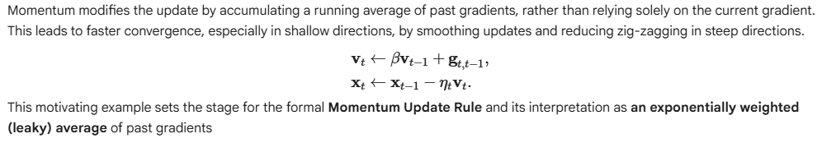
When to use?
When the optimization landscape has a large disparity in curvature accross direction
Two main benefits when adding momentum into GD:
Accelerating convergence faster
Smoothing the descent direction by incorporating past gradient by controlling β factor

Slide 13
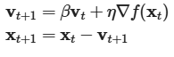
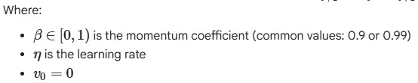
Momentum Update Rule
Momentum:
Introduces a velocity vector that accumulates past gradients.
Smooths noisy updates and accelerates movement in stable directions
The standard formulation used in deep learning (Sutskever et al., 2013) is:

Slide 14
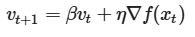
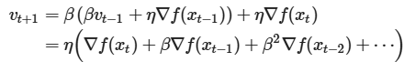
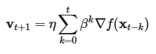

Momentum as an Exponential Weighted Average
Momentum Update Rule:
We can expand the recurrence:
Expanded Sum Representation:
This shows that:
Gradients from recent steps have large weight
Gradients from older steps decay exponentially
Momentum is literally a leaky average of past gradients

Slide 15

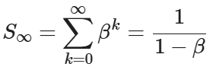
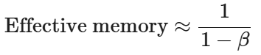

Effective Memory Length
Total mass of the geometric weights
Momentum is often said to have an effective memory length
Example:
β = 0.9 → remembers ~10 steps
β = 0.99 → remembers ~100 steps

Slide 16
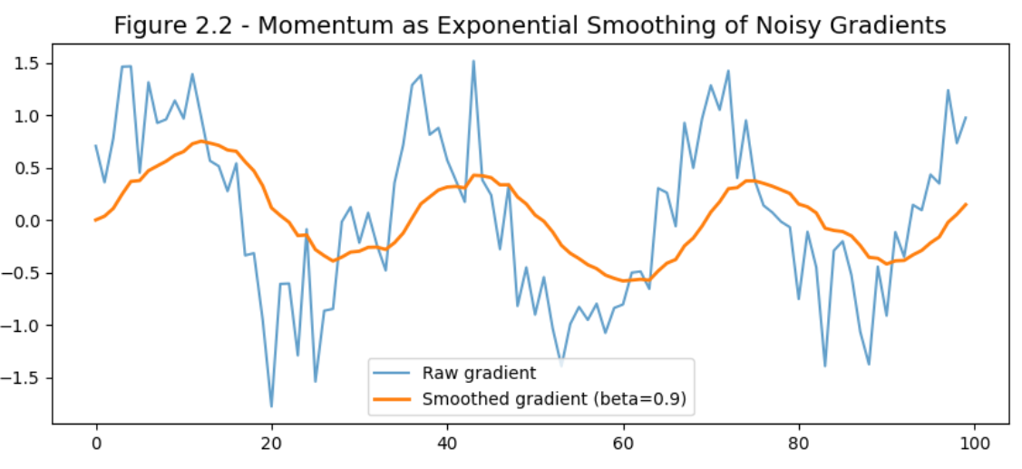
Smoothing Effect
Momentum smooths the gradient signal in two essential ways:
Cancels high-frequency noise
Amplifies consistent directions

Slide 17
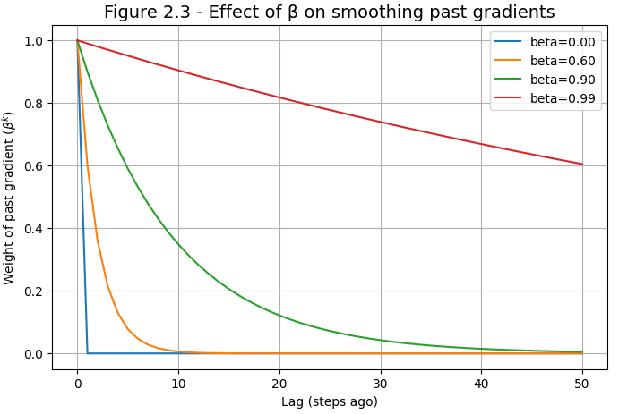
How β controls smoothing

Slide 18
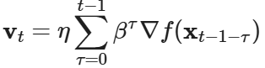
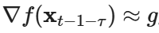
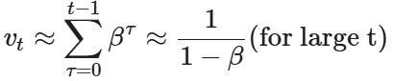
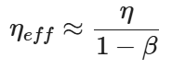
Why Momentum accelerates convergence
Recall the expanded form of the momentum velocity:
If gradients stay approximately constant, (assume g= 1.0) then:
Multiplying by the learning rate η gives an effective step size:

Slide 19
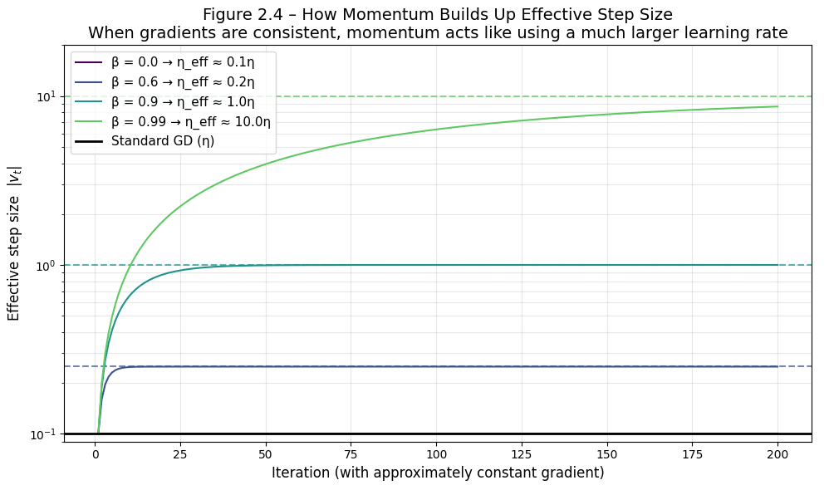
Why Momentum accelerates convergence

Slide 20
THEORETICAL
ANALYSIS
03

Slide 21
How GD & Momentum work in a mathematical way
This part will explain how and why gradient descent and momentum work in a mathematical way.
We need to prove that, in quadratic convex function:
Gradient Descent optimizes each direction independently, scaled by how steep that direction is → That’s why GD can be fast in steep direction and slow in shallow ones (Ill-conditioned problems)
Momentum addresses this issue by adding velocity based on past gradient and also acts separately in each direction.

Slide 22
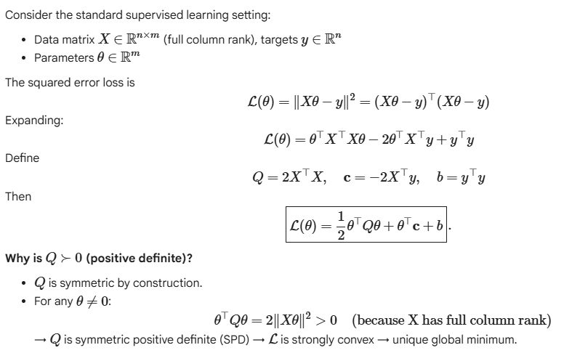
The Loss is Quadratic Convex

Slide 23
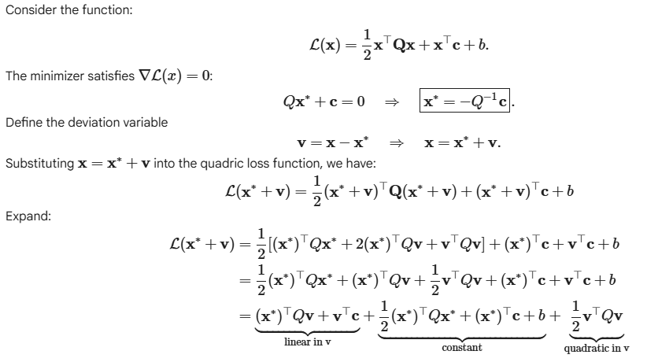
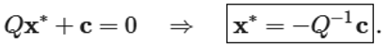
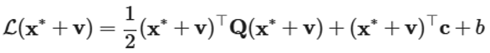
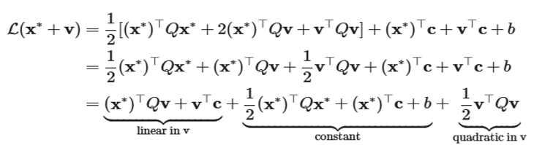
Shift Coordinates to the Minimum
Consider loss function:
The minimizer satisfies
Define the deviation variable
Substituting into the quadratic loss function, we have:
Expand:

Slide 24
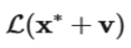
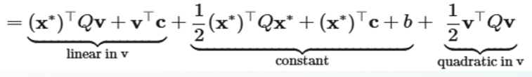
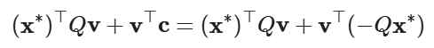
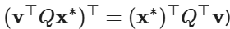
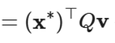
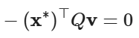
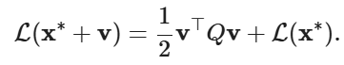
Shift Coordinates to the Minimum
By the linear term, we have:
Transpose property of a matrix product
Local quadratic expansion around the minimum

Slide 25
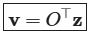
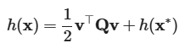
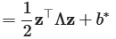
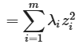
Eigen-Decomposition &
Decoupling
Spectral Decomposition (for real symmetric and positive definite)
Where:
Rotate Coordinates:
This rotation aligns the coordinate axes with eigenvectors of Q.
Quadratic in Rotated basis:
Now Q becomes diagonal, eliminating all cross terms.

Slide 26
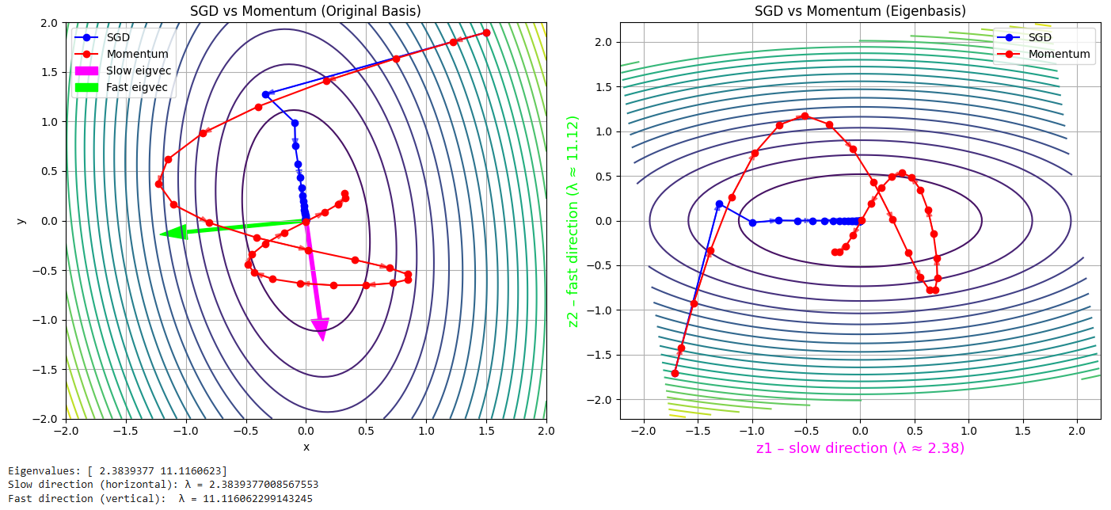
Eigen-Decomposition &
Decoupling

Slide 27
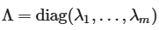
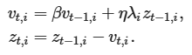
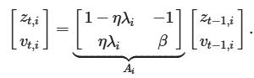
Dynamics of GD & Momentum in the Eigen-basis
After rotating coordinates:
Since each eigen-direction evolves independently.
Gradient Descent (1D per eigenvalue)
→ Flat directions (small 𝜆𝑖) ⇒ factor ≈ 1 ⇒ extremely slow convergence.
Momentum
Contraction factor becomes spectral radius of Ai​.
Massive acceleration in flat directions, unlike GD.

Slide 28

PRACTICAL
IMPLEMENTATION
04

Slide 29




Ill-conditioned quadratic function
Benchmark on MNIST dataset
Scalar function

Slide 30
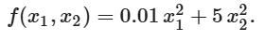
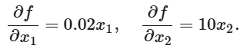
Ill-Conditioned Quadratic Function
Consider the ill-conditioned quadratic function:
The gradient of this function is:
With learning rate η=0.15, we examine the behavior of standard Gradient Descent :
Along the x1 direction (small curvature): Contraction factor is (1 − η . 0.02)=0.997
⇒ x1 decreases extremely slowly (requiring thousands of steps to reach 0).
Along the x2 direction (large curvature): Contraction factor is (1− η ⋅ 10)= −0.5
⇒ x2 changes sign at each step and exhibits strong oscillations (zig-zag)
To address this issue, we apply Momentum with β=0.9.

Slide 31
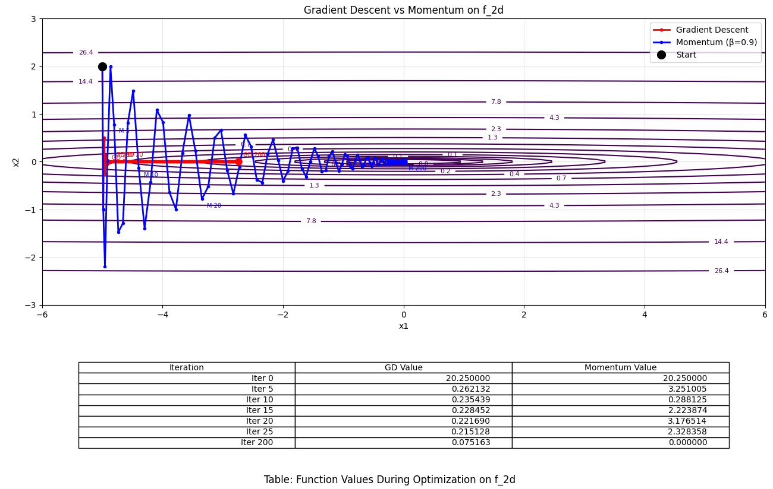
Ill-Conditioned Quadratic Function

Slide 32
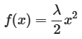
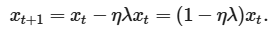
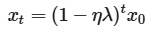
Scalar Function
Using Gradient descent
We analyze a simple scalar quadratic function:
Using Gradient descent:
This optimization converges at exponential rate since after t steps:
Behavior of convergence depends on the factor (1−ηλ):
If |1 − ηλ| < 1⇔ 0 < ηλ < 2 then xt→0: the algorithm converges
If |1 − ηλ| > 1 then x → ∞: the algorithm diverges
If |1 − ηλ| = 1 → ηλ = 2/ηλ = 0: never converge

Slide 33
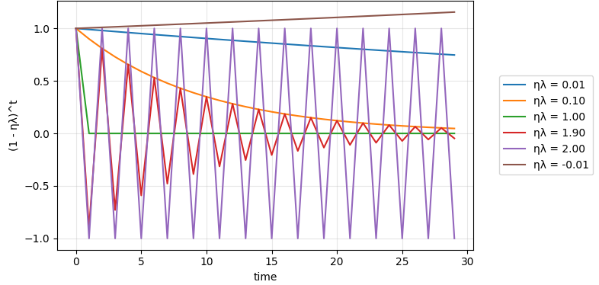
Scalar Function
Using Gradient descent
The chart below showing how x_{t}/x₀ change over time - how fast the variable converges to 0 under different values of 1 − ηλ.

Slide 34
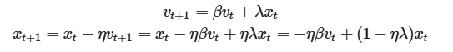
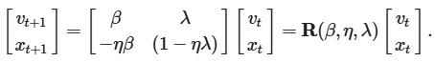
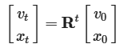
Scalar Function
Using Momentum
Converting to matrices:
After t iterations:
The method converges if and only if the spectral radius is strictly less than 1:
Stability region for Momentum:

Slide 35
Training Neural Networks
Input (28 x 28)
1. Dataset:
60 000 training images, 10 000 testing images
28 x 28 grayscale
Flatten → 784 features
2. Runtime environment: Google Colab CPU
Linear 784 → 128
3. Batch size:
Mini-batch = 64
ReLU
Linear 128 → 64
4. Benchmark:
Vanilla SGD: β = 0.0
SGD + Momentum: β = 0.9
SGD + High Momentum: β = 0.99
ReLU
Linear 64 → 10 logits

Slide 36

Momentum performs better of time and accuracy

Slide 37
EXERCISES
05

Slide 38



Exercise 1:
Use other combinations of momentum hyperparameters and learning rates and observe and analyze the different experimental results.
We calculate gradient descent:
Momentum Update:

Slide 39

Exercise 1:

Slide 40




Exercise 2:
Try out gradient descent and momentum for a quadratic problem where you have multiple eigenvalues, i.e.,
Plot how the values of x decrease for the initialization
We calculate gradient descent use the formula:
Momentum Update:

Slide 41

Exercise 2:

Slide 42


Substituting x∗ into h(x) gives
Exercise 3:
Problem statement: Derive the minimizer and minimum value of the quadratic
Step 1: Derive with respect to x:
Step 2: To find the minimizer, set the gradient to 0
Step 3: Substitute x* into h(x*)

Slide 43


Substituting x∗ into h(x) gives
Exercise 3:
Let take a numerical example to understand more:
Let
From previous result, we have:

Slide 44


Substituting x∗ into h(x) gives
Exercise 3:
Let take a numerical example to understand more:
Replace the result into the origin function to find minimum, we have:
Thus,

Slide 45


Exercise 4:
Problem statement: What changes when we perform stochastic gradient descent with momentum?
Stochastic Gradient Descent (SGD) updates parameters using noisy gradients from one sample (or a mini-batch).
Without Momentum:
With Momentum:
Key changes:
Smoother updates - noise is filtered by the velocity term.
Faster convergence, especially in shallow or flat regions.
Reduced oscillation along steep directions.

Slide 46


Exercise 4:
Consider function:

Slide 47

Exercise 4:
Problem statement: What happens when we use minibatch stochastic gradient descent with momentum?
Stochastic Gradient Descent (SGD): updates parameters using one sample, so the gradient is very noisy.
Mini-batch SGD: uses a small batch (e.g., 16 or 32 samples), reducing noise while keeping updates fast.
Momentum: accumulates past gradients to smooth the trajectory and speed up convergence.
→ So when we combine them: Each step uses the average gradient over a mini-batch, and Momentum accumulates these batch-gradients over time.
This produces (with momentum):
Faster convergence than plain mini-batch SGD
Lower variance in updates
A smoother path through the optimization landscape

Slide 48


Exercise 4:
Consider function:

Slide 49

06
Summary
Momentum replaces the raw gradient with a leaky average of past gradients.
It is desirable for both noise-free gradient descent and (noisy) stochastic gradient descent.
The effective number of past gradients that influence each update is approximately:
For convex quadratic functions, momentum can be analyzed exactly
Momentum is easy to implement and widely supported. The only additional requirement is storing a velocity vector alongside the parameters.

Slide 50




Mathematical Foundations for Computer Science
THANK YOU FOR LISTENING
Date: December 13, 2025

